Slide 1
Smart Defence System
A Comprehensive Approach to Detecting Fraudulent Activities

Slide 2
Problem Statement
Overview :
Increasing fraudulent activities via digital channels.
Email and Text Messages :
Spam, phishing emails, and texts lead to data breaches and financial losses.
Websites :
Malicious websites pose security risks, including malware and phishing attacks.

Slide 3
Benefit of Smart Defense System
Enhanced Security: Protects users from phishing, scams, and malware.
Time Efficiency: Filters out spam communications, saving users' time.
User Trust: Builds trust with secure communication.
Automated Detection: Reduces manual intervention with machine learning.
Data Privacy: Protects users' data by blocking malicious entities.

Slide 4
End Users
Individual
General Public: Protects everyday users from spam and scams.
Businesses
Small to Medium Enterprises (SMEs): Safeguards business communications and prevents data breaches.
Educational
Institutions
Schools and Universities: Secures communication channels for students, faculty, and administration.
Government
Organizations
Public Sector Employees: Protects governmental data and communication from malicious attacks.
Elderly and Vulnerable Populations: Provides additional protection for those who are often targeted by scammers.
Large Corporations: Ensures security and compliance in extensive communication networks.
Law Enforcement Agencies: Assists in tracking and mitigating fraudulent activities.

Slide 5
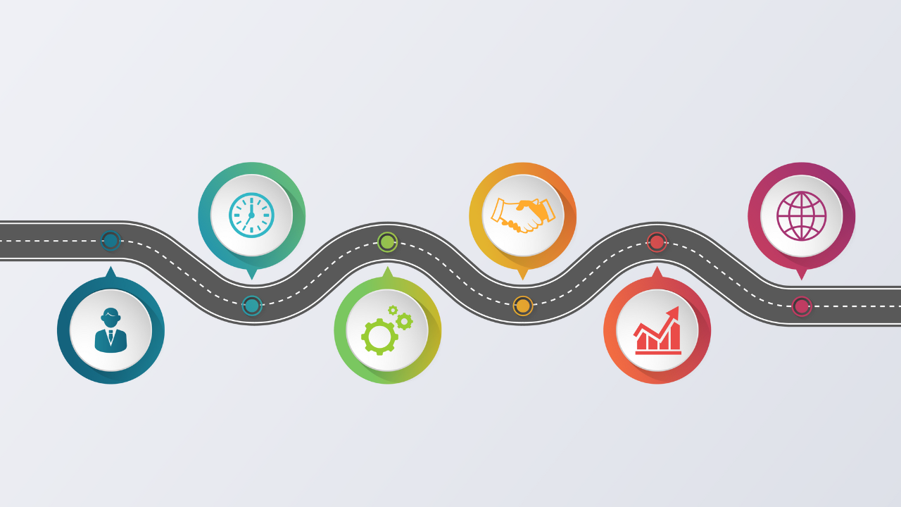
Road Map for Smart Defence

Slide 6
1. Technologies We are using
Frontend and Backend Frameworks:
Frontend: - Python , Flask , Django
Backend: Python with machine learning libraries (e.g., Pandas , numpy , sklearn , Scikit-learn, TensorFlow , PyTorch).

Slide 7
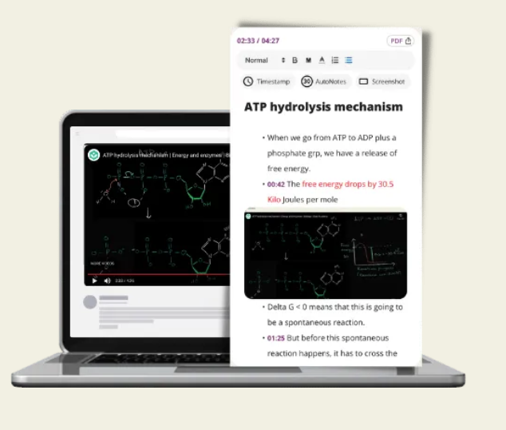
2. Architecture
Frontend: We are creating an Responsive webpage with basic website Features Like Navbar, Contact Page and Some Information About our application.
Backend: Use Flask or FastAPI to create a backend service for model inference.

Slide 8
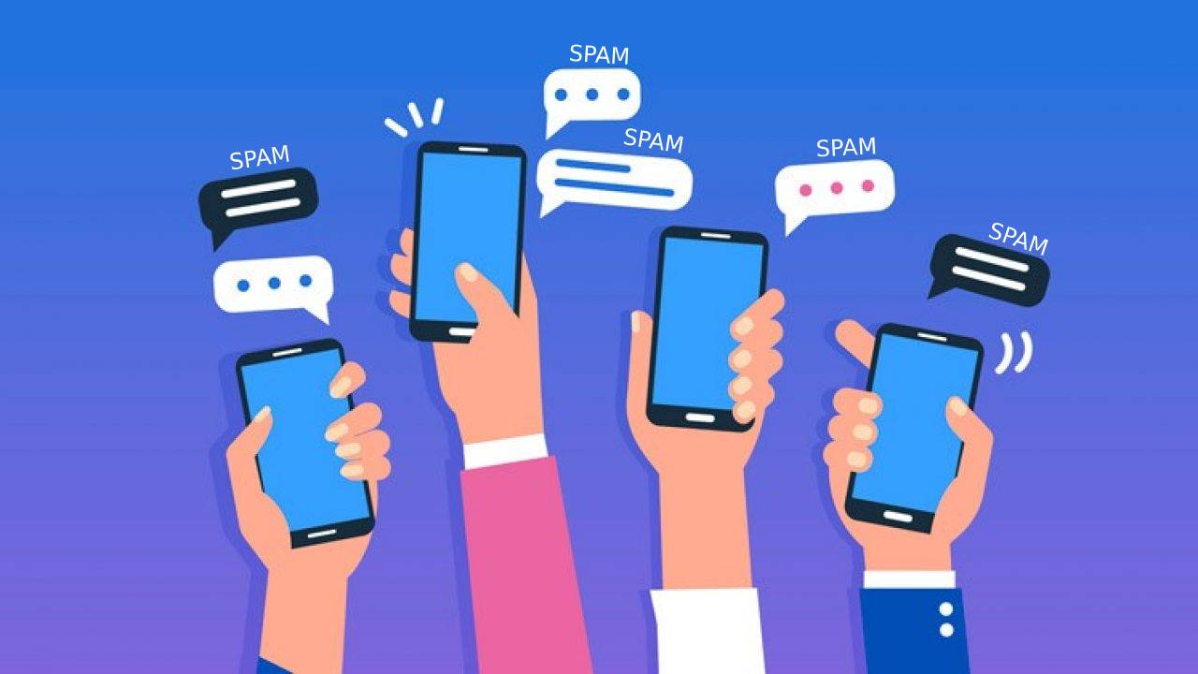
3. Our Objectives
Email Spam
SMS Spam
Links Spam etc.

Slide 9
Data Collection
Messages: Collect a dataset of labeled emails and text messages (spam vs. non-spam).
Sources: Enron Email Dataset, SMS Spam Collection, public email datasets.
Websites: Collect a dataset of websites labeled as trustworthy or malicious).
Sources: Public datasets like the Web of Trust (WOT), PhishTank, Alexa Top Sites.

Slide 10
Data Preprocessing
Cleaning: Remove irrelevant information, handle missing values, and normalize the data.
Feature Extraction:
Messages: Use techniques like TF-IDF, word embeddings (e.g., Word2Vec, BERT).
Websites: Extract features such as URL length, presence of HTTPS, domain age, content analysis.

Slide 11
Model Selection and Training
Messages:
Use classification algorithms like Logistic Regression, Random Forest, Gradient Boosting, or deep learning models like LSTM, BERT.
Websites:
Use algorithms like Random Forest, Support Vector Machine, or deep learning models like CNNs for content analysis.
Model Training:
Split the data into training and test sets, perform cross-validation, and tune hyperparameters.

Slide 12
Evaluation
Metrics: Use accuracy, precision, recall, F1-score, ROC-AUC to evaluate model performance.
Confusion Matrix: To understand false positives and false negatives.

Slide 13
Team Member
Vidushi
Renu
Sheetal
Anju Kumari

